Slide 1
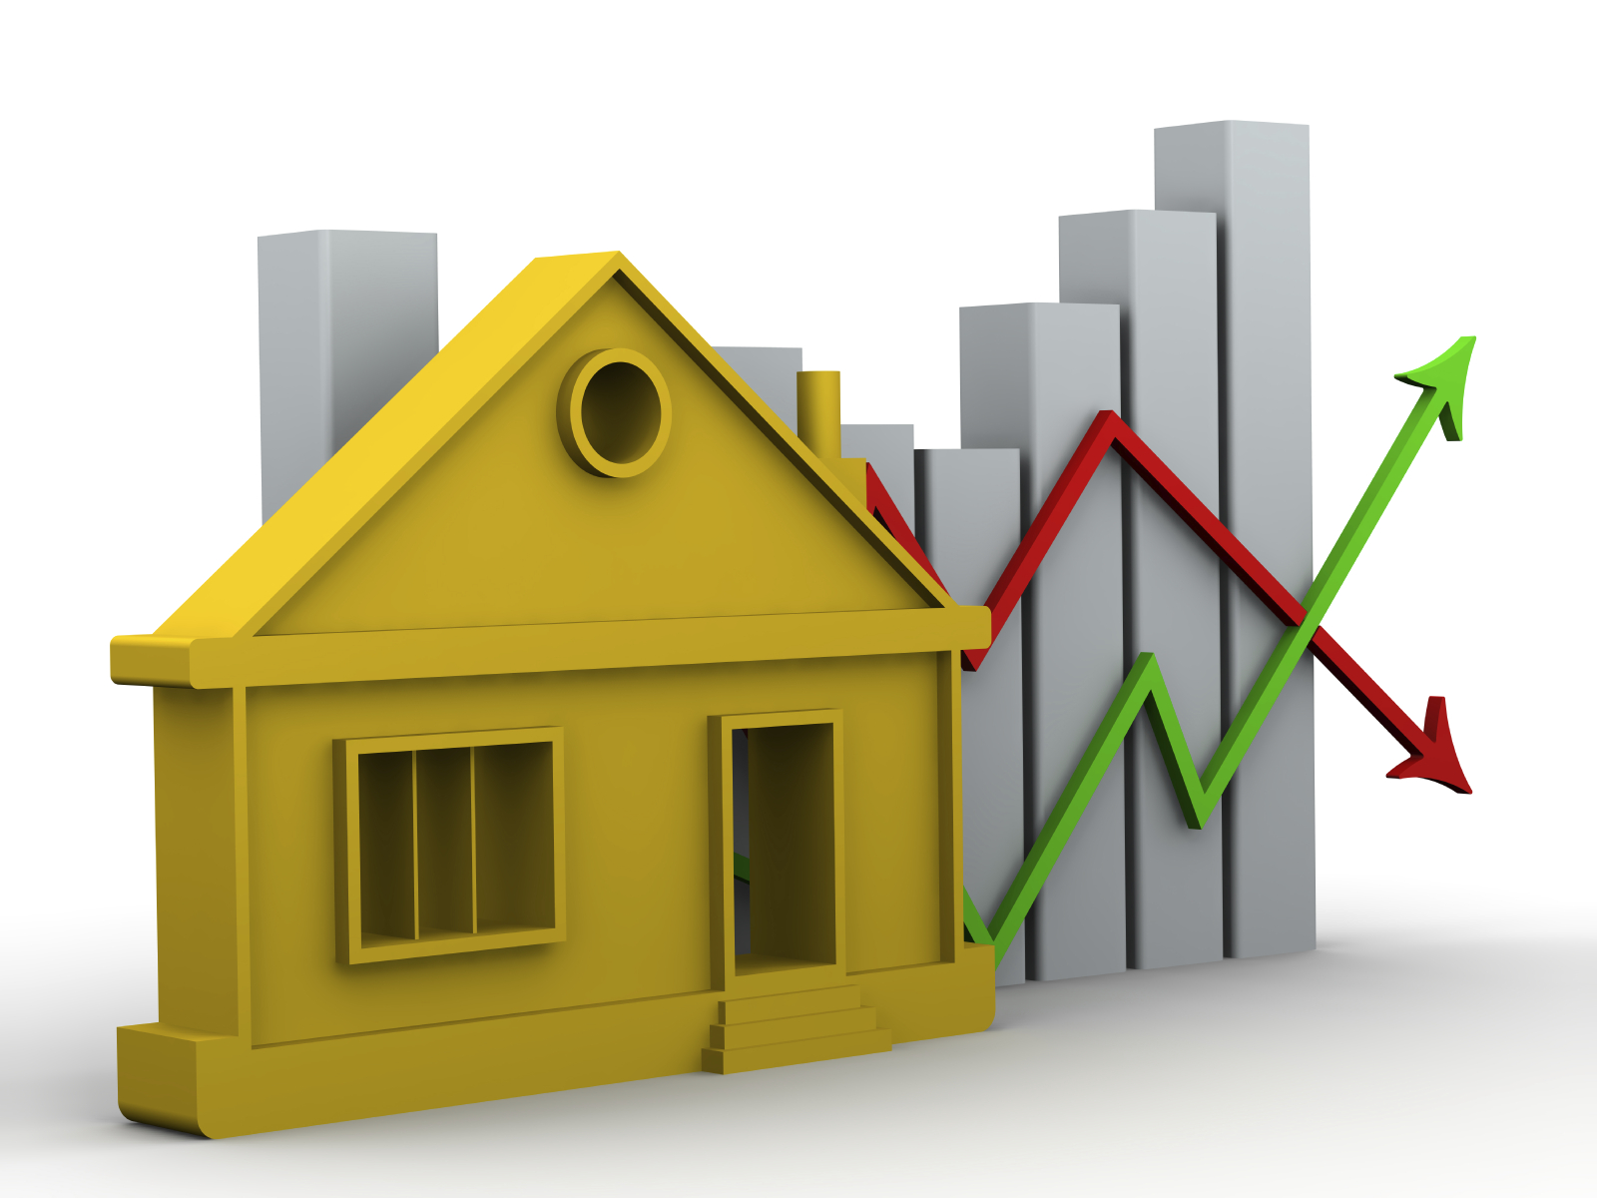
Home Price prediction using Machine Learning
Mahesh Kuntumalla(R161249)
Hemanth Mekala(R161871)

Slide 2
OUTLINE
  Problem statement
  Project overview
  Technology used
  Tools used
  How it works
  What it does and execution

Slide 3
Problem statement
  Prediction house prices are expected to help people who plan to buy a house so they can know the price range in the future, then they can plan their finance well. In addition, house price predictions are also beneficial for property investors to know the trend of housing prices in a certain location.

Slide 4
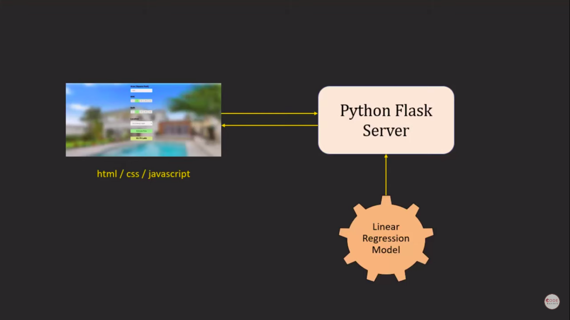
Project overview

Slide 5
Technologies used
Machine Learning:-
  is a method of data analysis that automates analytical model building. It is a branch of artificial intelligence based on the idea that systems can learn from data, identify patterns and make decisions with minimal human intervention.

Slide 6
  Python flask server at the backend
  HTML,CSS,java for frontend view

Slide 7
Tools used
  Jupyter Notebook
  Pycharm
  Visual studio code

Slide 8
How it works
  Collectiong data
  Data cleaning
  Feature Engineering
  Outlier removal
  One hot encoding
  Model building

Slide 9
Collecting data :-
  it the process of collecting information which we will furthur used to train our model
Data Cleaning :-
  Data cleaning refers to identifying and correcting errors in the dataset that may negatively impact a predictive model.

Slide 10
Feature Engineering :-
  it refers to the process of using domain knowledge to select and transform the most relevant variables from raw data when creating a predictive model using machine learning
Outlier removal :-
  Outliers are extreme values that fall a long way outside of the other observations.They can be caused by measurement or execution error.

Slide 11
One hot encoding :-
  One hot encoding is a process of converting categorical data variables so they can be provided to machine learning algorithms to improve predictions. One hot encoding is a crucial part of feature engineering for machine learning.

Slide 12
Model building :-
  A machine learning model is built by learning and generalizing from training data, then applying that acquired knowledge to new data it has never seen before to make predictions and fulfill its purpose.
  Linear regression

Slide 13
Linear Regression :-
  Linear Regression is a supervised machine learning algorithm where the predicted output is continuous and has a constant slope. It's used to predict values within a continuous range

Slide 14
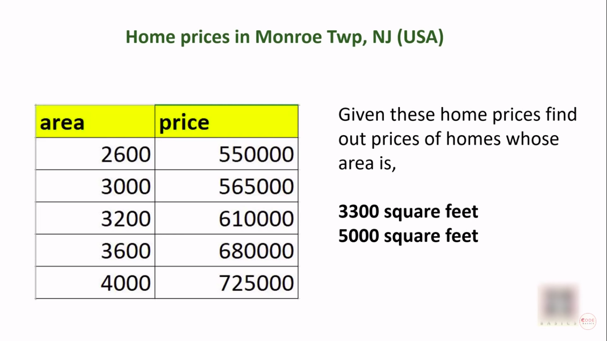
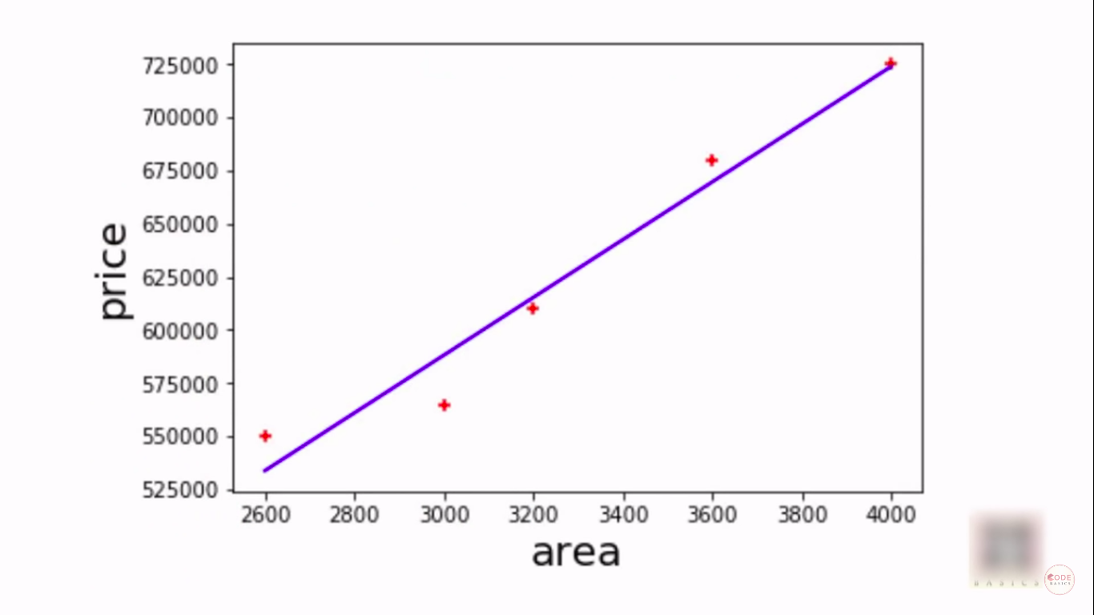
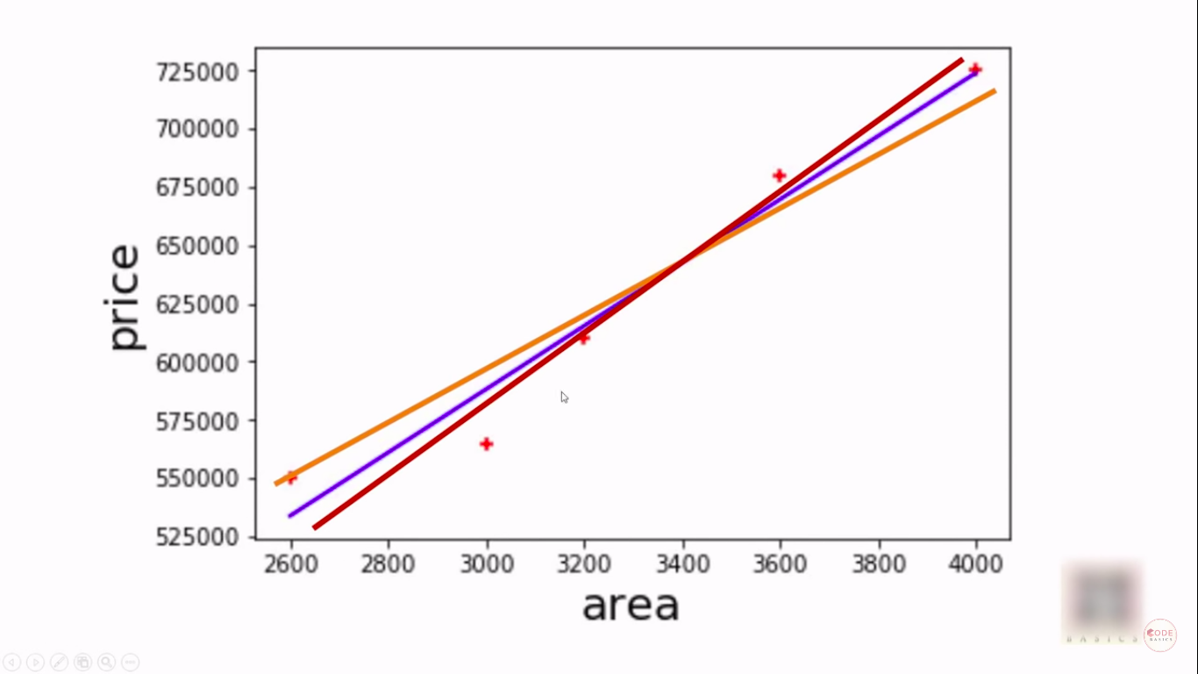
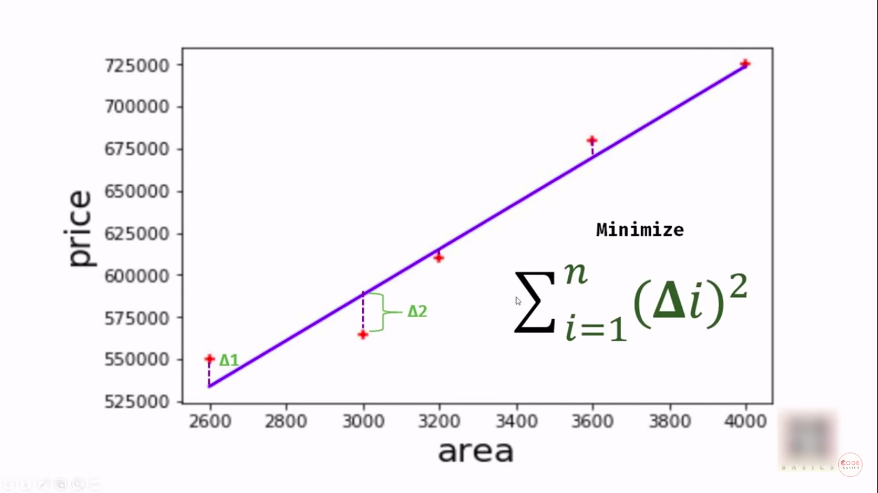
Linear regression explanation

Slide 15
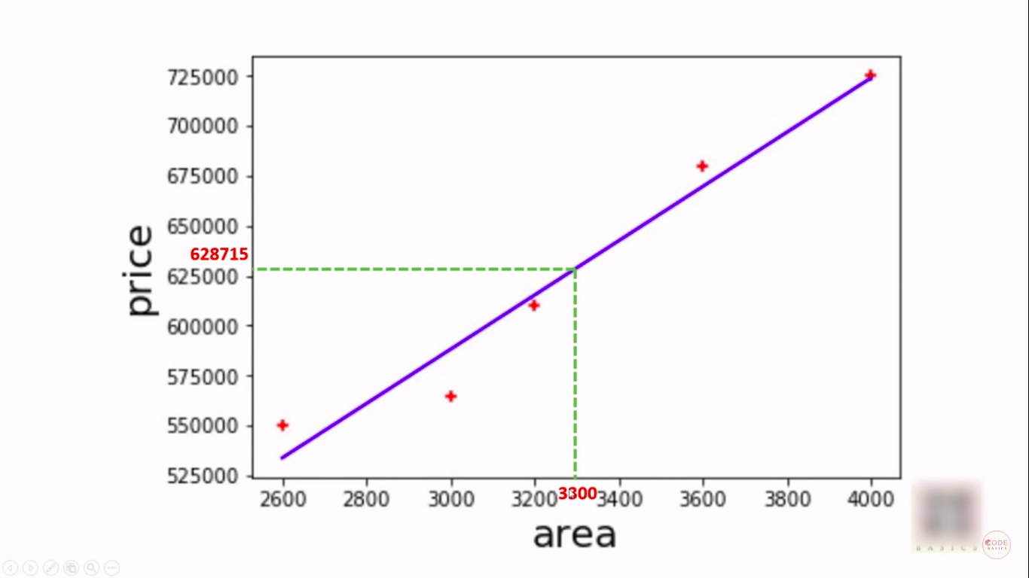
How it predicts the price

Slide 16
Now its execution time

